Slide 1

R-Ladies Nairobi Launch
8th August 2020
11:00 am- 13:15 pm GMT+3

Slide 2
Agenda
Time | Session | Speaker(s) | Moderator
11:10 - 11:20 | Opening remarks | Lucy Njoki
11:20 - 11:35 | R-Ladies Global & R-Ladies Nairobi organisers | Lucy Njoki
11:35 - 11:45 | R-Ladies chapters (Africa & worldwide) | Faith Musili
11:45 - 12:25 | Lessons from other R ladies groups | Vebashini Naidoo & Paloma Rojas - Saunero | Faith Musili
12:25 - 12:30 | Break
12:30 - 12:50 | My journey with R | Shel Kariuki | Maggie wanjiru
12:50 - 12:55 | Results of the pre-launch survey | Maggie Wanjiru
12:55 - 13:05 | What to expect from R-Ladies Nairobi & code of conduct | Maggie Wanjiru, Faith Musili & Lucy Njoki
13:05 - 13:15 | Feedback from the audience & Next steps | All participants | Lucy Njoki

Slide 3
R-Ladies Global mission and vision
R-Ladies Global is a worldwide organization whose mission is to promote gender diversity in the R community.
Unfortunately, the R community suffers from underrepresentation of minority groups (including but not limited to cis/trans women, trans men, non-binary, genderqueer, agender) in every role from the leaders, package developers, conference speakers and participants, educators and users.
For example, in 2016, only 9 % of package developers were ladies or members of minority groups and 11.4% of package maintainers were ladies or members of minority groups. (http://forwards.github.io/data/).

Slide 4
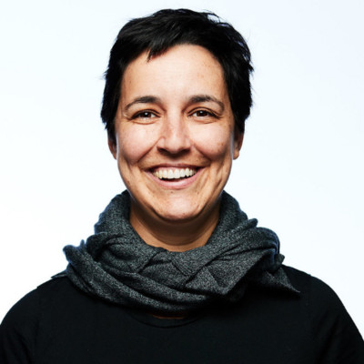
History of R-Ladies Global
R-Ladies was founded on 1st October 2012 by Gabriela de Queiroz. Her aim was to give back to society, empower women and promote gender diversity in the R community. The meet-up was held in San Francisco, California, US.
In the following year, two more chapters were launched in Twin Cities and Taipei. In 2016, the London chapter was launched.
R-Ladies Global created on September 2016.
Since then the number of chapters has grown to 189 with 69,683 members, as of 2019.

Slide 5
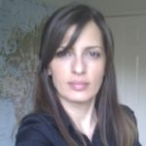
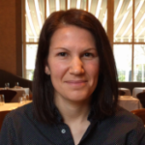
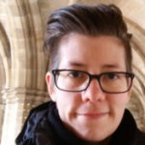

Current R-Ladies Global Leadership Team
Claudia Vitolo
Erin LeDell
Hannah Frick
Laura Acion

Slide 6
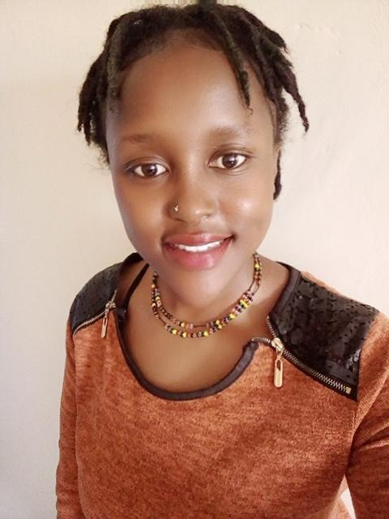
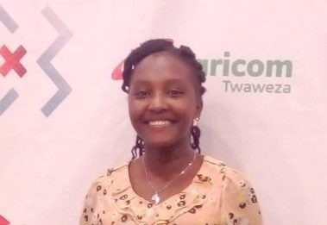
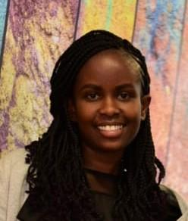
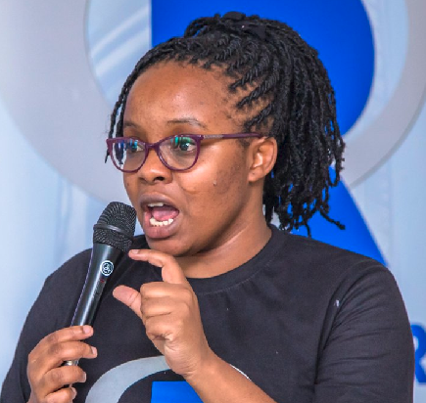
R-Ladies Nairobi Organizers
Lucy Njoki (Organizer)
Maggie Wanjiru (Co-organizer)
Faith Musili (Co-organizer)
Shelmith Kariuki
(Co-organizer)
Biostatistician
Senior Data Analyst , Co-organizer- AfricaR & NairobiR
Financial Risk Analyst
Senior Data Analyst

Slide 7
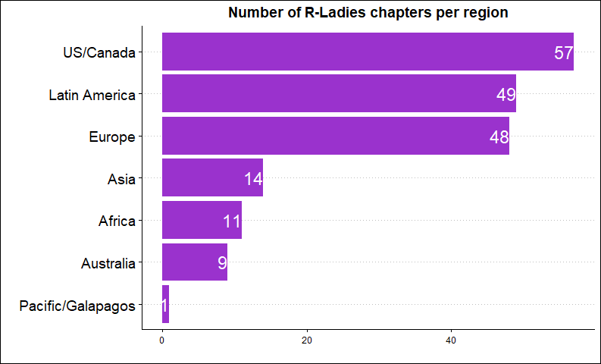
R-Ladies chapters
Currently, there are 189 chapters in 54 countries with 69,683 members.

Slide 8
R-Ladies chapters dashboard
https://benubah.github.io/r-community-explorer/rladies.html.

Slide 9
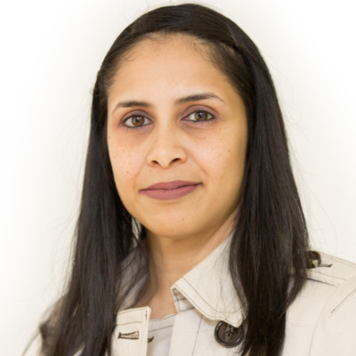
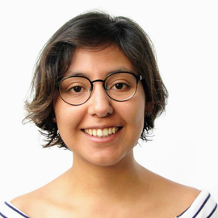
Lessons from other R-Ladies chapters
Vebashini Naidoo
Paloma Rojas - Saunero
R-Ladies Johannesburg organizer
R-Ladies Rotterdam organizer

Slide 10
Break time
During our 5-minute break, please post any questions you have to the organisers, Vebashini or Paloma on the chat.

Slide 11
My journey with R
Shelmith Kariuki
Senior Data Analyst , Co-organizer- AfricaR & NairobiR

Slide 12
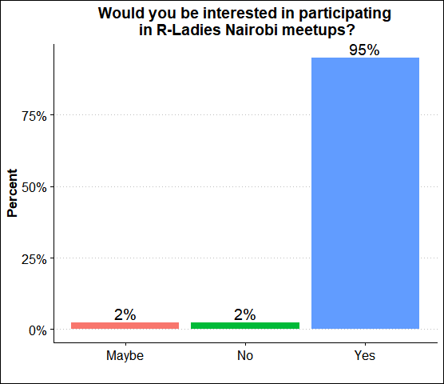
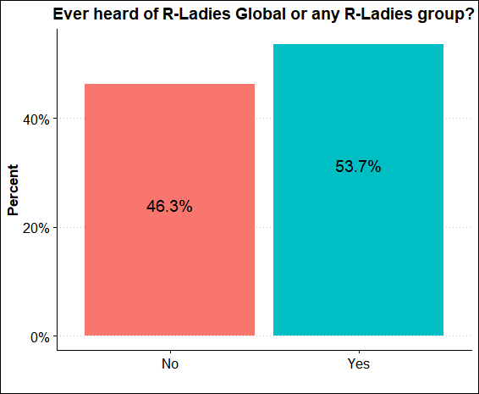
Results of the pre-launch survey (n = 42)

Slide 13
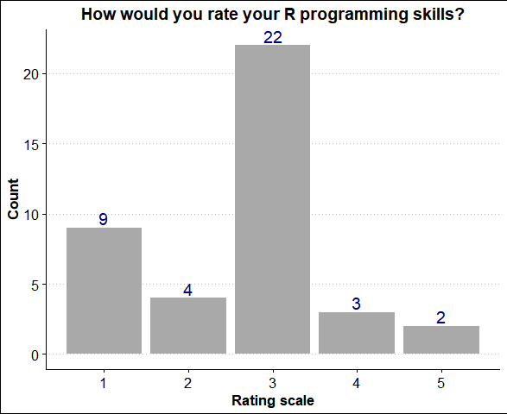
Results of the pre-launch survey
Where;
1 - Beginner R User
5 - Advanced R User

Slide 14
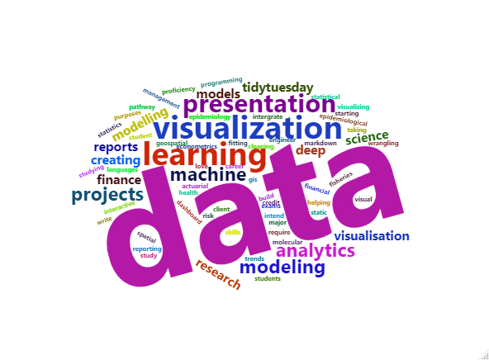
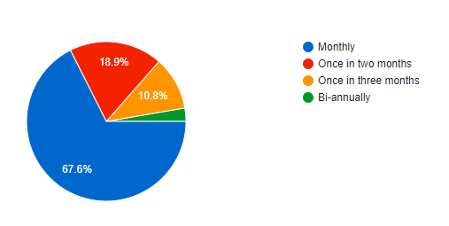
Results of the pre-launch survey
4) Aspects of your work or everyday activities you use/need R for
5) Frequency of the R-Ladies Nairobi meetup sessions

Slide 15
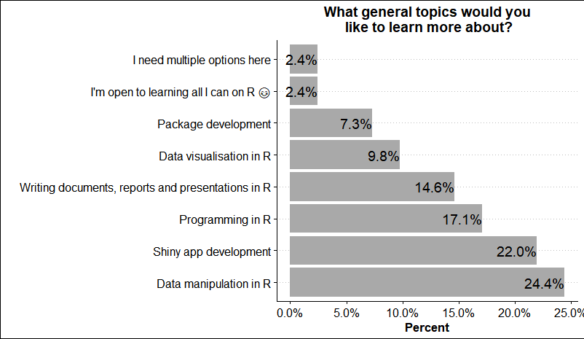
Results of the pre-launch survey

Slide 16
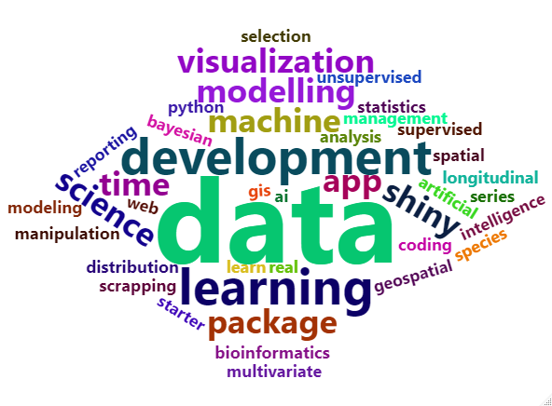
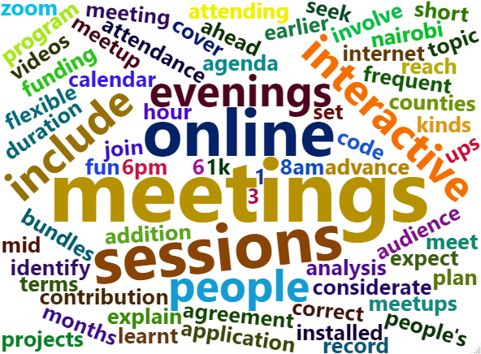
Results of the pre-launch survey
7) Any other topics you would like to learn about
8) Thoughts on making planning and execution of the meetups more accommodative and effective

Slide 17

What to expect from R-Ladies Nairobi
Expectations for R-Ladies Nairobi( from survey)
A safe space to grow your network and R skills.
A community dedicated to promote and improve gender diversity in Nairobi R community.
An avenue to share your R skills with others.

Slide 18
Code of Conduct
We will strictly follow the Code of Conduct provided by the R-Ladies Global [https://rladies.org/code-of-conduct/].
R-Ladies is committed to providing a harassment-free experience for everyone, and harassment of participants in any form is not tolerated.
Harassment include:
Offensive comments related to gender, gender identity and expression, sexual orientation, disability, mental illness, neuro(a)typicality, physical appearance, body size, age, race, or religion.

Slide 19
Harassment continuation
Unwelcome comments regarding a person’s lifestyle choices and practices, including those related to food, health, parenting, drugs, and employment.
Gratuitous or off-topic sexual images or behaviour in spaces where they’re not appropriate.
Threats of violence.
Incitement of violence towards any individual, including encouraging a person to commit suicide or to engage in self-harm.

Slide 20
Harassment continuation
Deliberate intimidation.
Harassing photography or recording, including logging online activity for harassment purposes.
Continued one-on-one communication after requests to cease.
Deliberate “outing” of any aspect of a person’s identity without their consent except as necessary to protect vulnerable people from intentional abuse.
Publication of non-harassing private communication.

Slide 21
Code of Conduct Cont.
The code of conduct is applicable to all R-Ladies spaces, including meetups, Twitter, Slack, mailing lists, both online and offline.
Anyone who violates this code of conduct may be sanctioned or expelled from these spaces at the discretion of the Global Leadership Team.

Slide 22
Feedback from the participants
Please, type on the chat for any feedback and questions.

Slide 23
Next steps
Meetups will take place every month.
The meetups will include talks, tutorials, hands-on workshops and seminars.
This year’s meetup calendar will be shared on meetup in two weeks time. Kindly join our meetup page if you haven’t and follow us on Twitter and LinkedIn to stay updated.

Slide 24

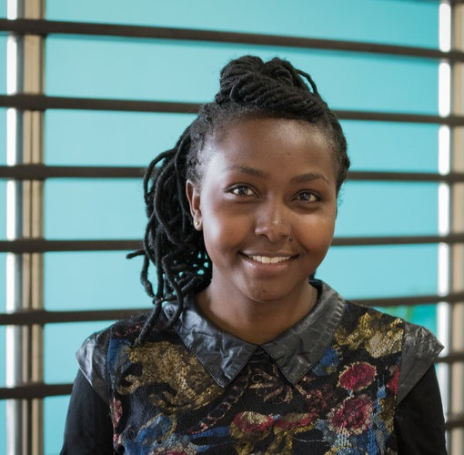
R-Ladies Nairobi
Data Manipulation in R - Part 1
September 5th, 2020
11:00 am - 12:30 pm
GMT +3
Naomi Ng’ang’a
Data analytics and visualization officer
International Centre for Humanitarian Affairs(ICHA)-Kenya Red Cross
For RVSP : bit.ly/RLadiesNairobi

Slide 25
THANK YOU
Email address: nairobi@rladies.org
LinkedIn: R-Ladies Nairobi
Twitter: @RLadiesNairobi
Meetup: https://www.meetup.com/rladies-nairobi/

